Slide 1
Human-Centric Mobility
Human-Centric Powered Wheelchair
User Focused Mobility

Slide 2
Topics
Toyota
Testbeds
HRI

Slide 3
Research Roadmap
SLAM
Autonomous Path Planning
Shared Control
Benefits – Safety/Social/Mental/Perception
Use SoA
Novel Techniques
Justification

Slide 4
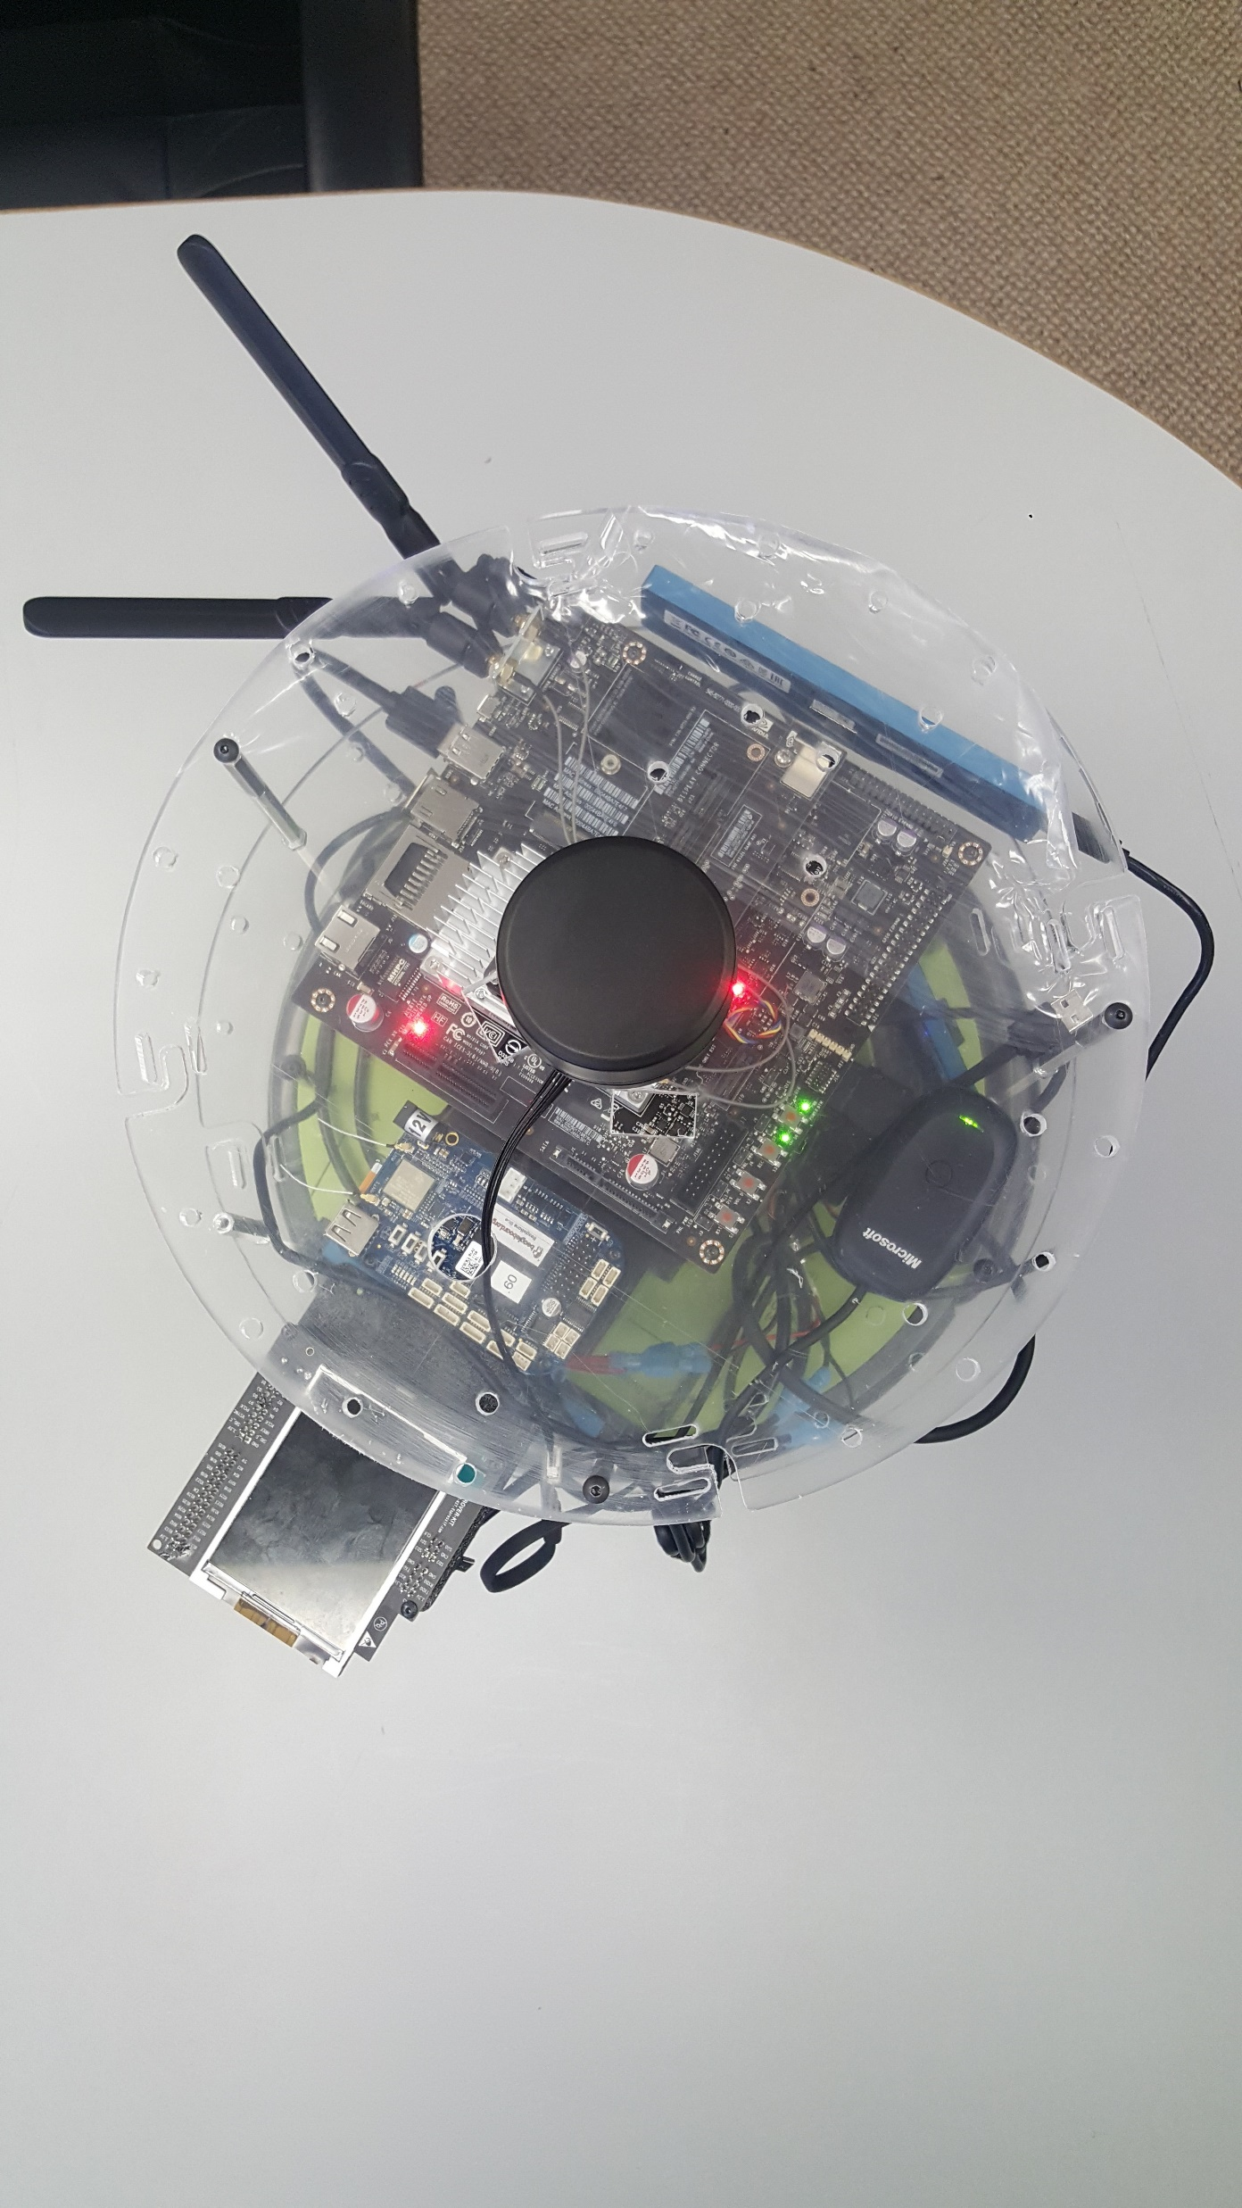
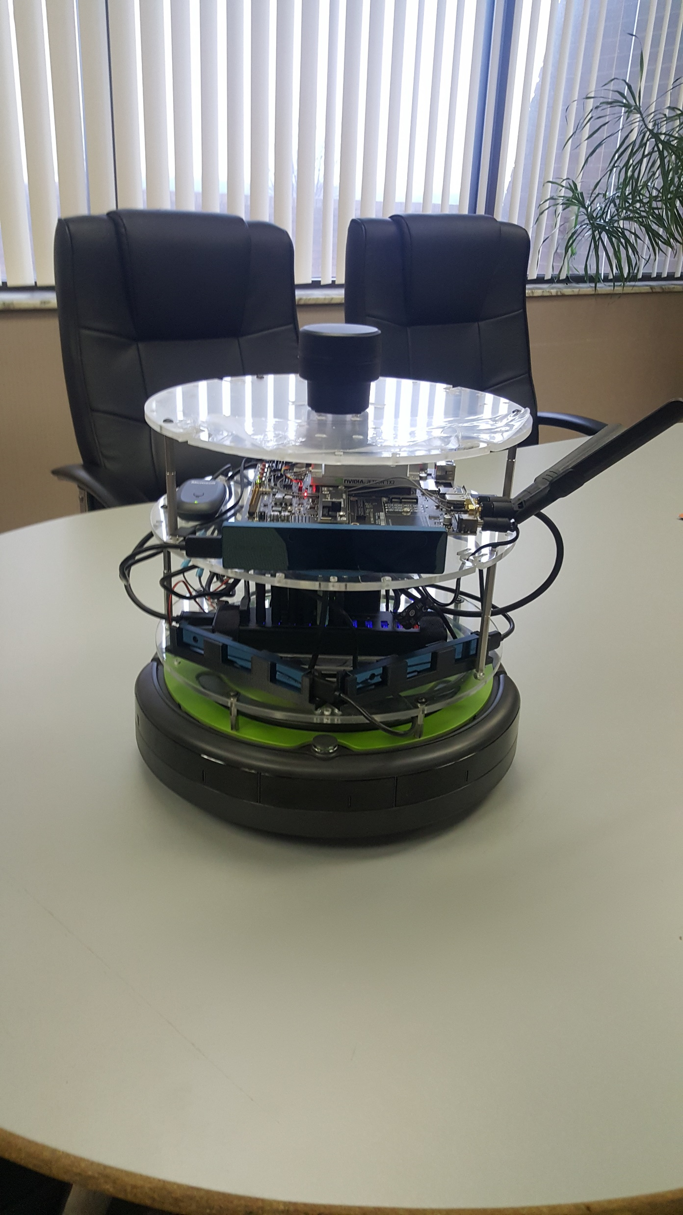
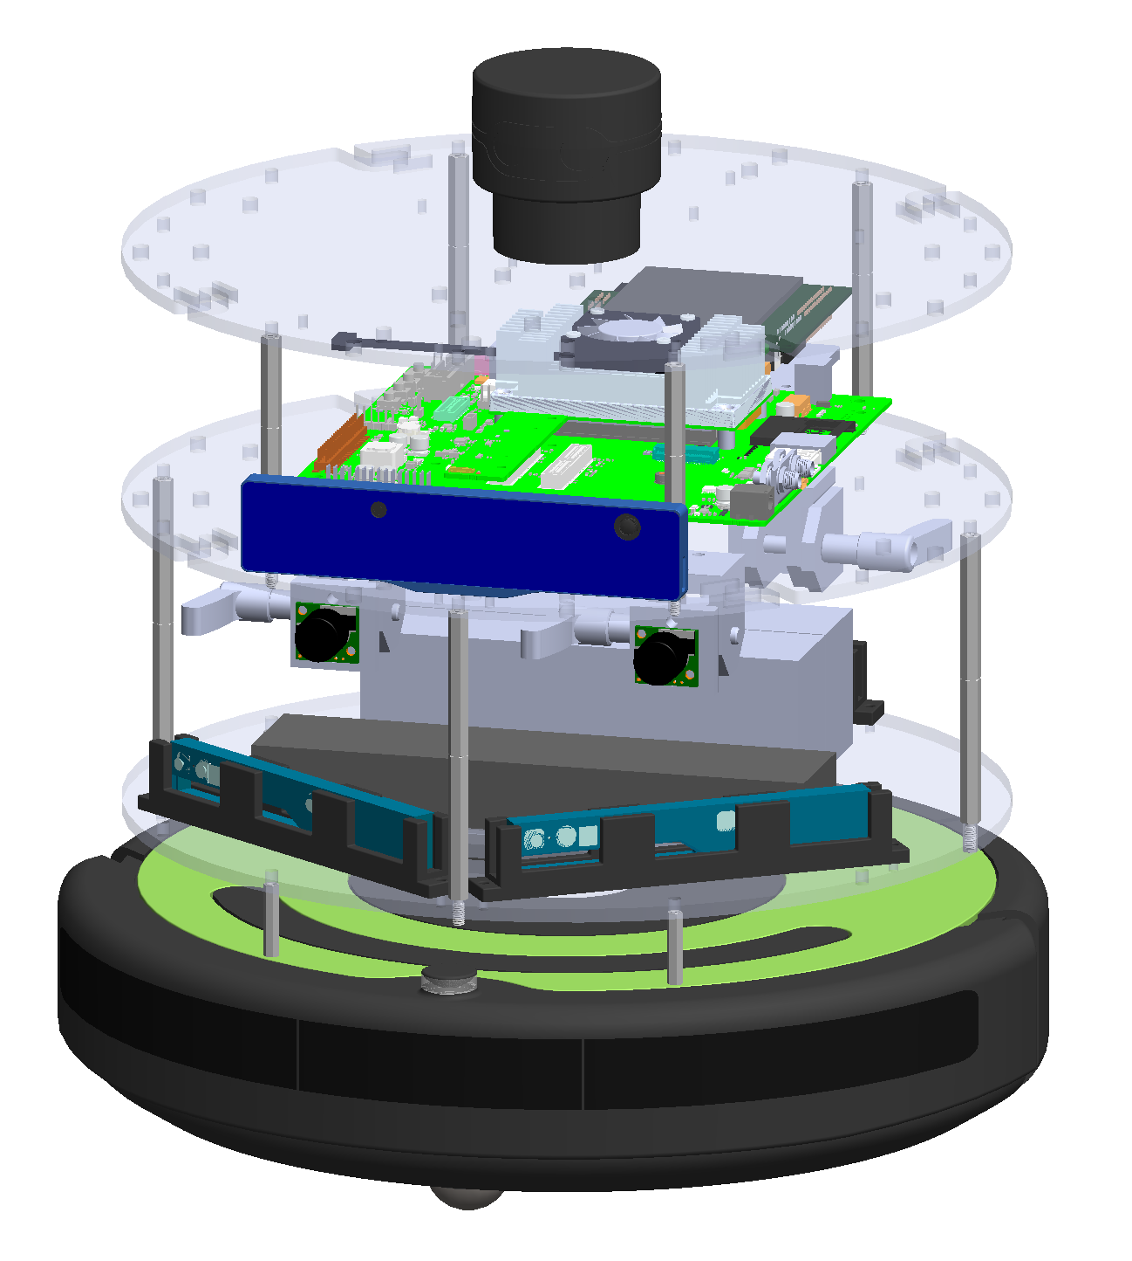
SLAM Testbed

Slide 5
Hardware
Jetson TX2
3 RealSense R200
RealSense ZR300
iCreate2 Base
Odometry
ScanseSweep LIDAR (upgrading soon)

Slide 6
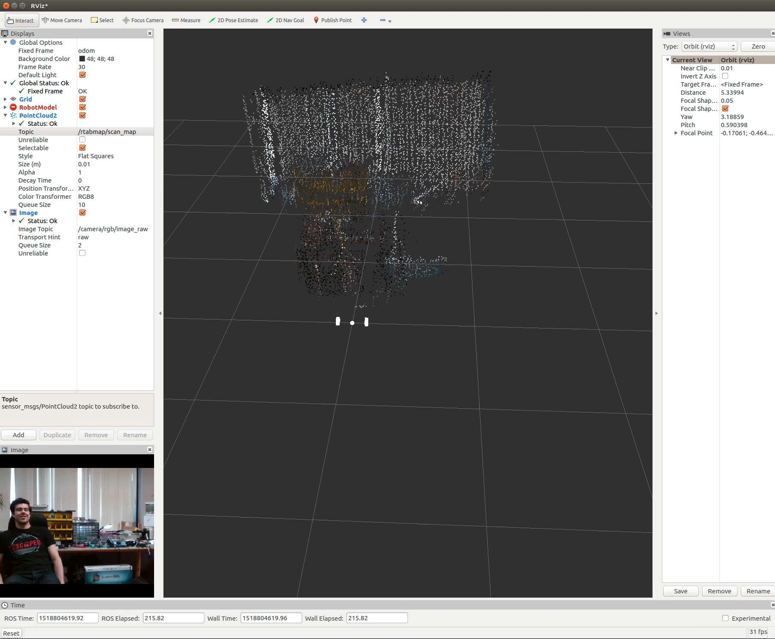

Slide 7
HRI

